Slide 1
NE 591: Advanced Reactor Materials
Fall 2021
Dr. Benjamin Beeler

Slide 2
Last Time
Talked through SiC
SiC is the primary fission product barrier/pressure vessel for TRISO particles
Low T radiation damage is primarily BSDs, Frank interstitial loops and voids start to form at medium to high temperatures
Swelling saturates with dose if in the low T regime (point defect swelling regime); Void swelling dominates at high T, with no saturation
Extensive thermal conducitivty degradation exists under irradiation; more prevalent at low T, as point defects are more efficient phonon scatterers
SiC is susceptible to fission product corrosion, namely Pd

Slide 3
Graphite

Slide 4
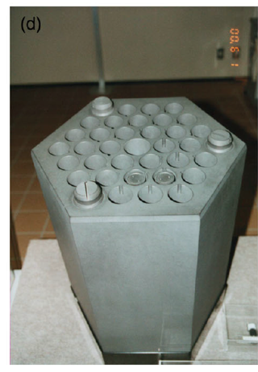
Graphite Usage
Graphite was the moderator in the first reactor to sustain a chain reaction and has been used as a moderator in over 100 nuclear reactors, many of which are still operating
Graphite has a high neutron scattering cross-section and a very low neutron absorption cross-section, making it an ideal moderator

Slide 5
Delineate Types of Graphite
TRISO Graphite
CVD deposition
treated to ensure ultra dense and high purity
Prismatic Blocks and Pebbles
large scale
different fabrication process from TRISO
different microstructure
We will generally be talking about graphite, which most directly applies to prismatic block type graphite
Similar radiation effects are assumed to occur in PyC layers

Slide 6
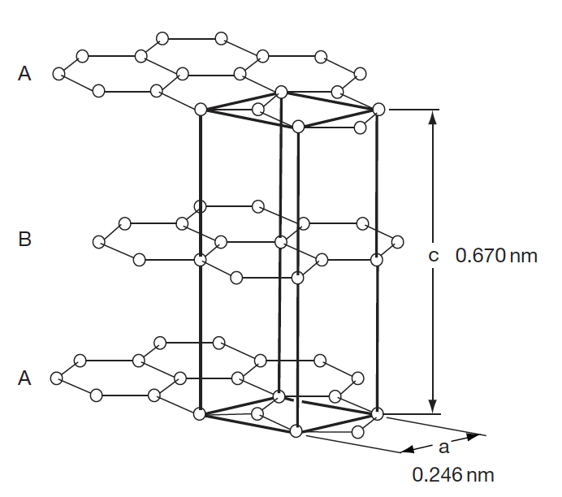
Graphite Structure
The electronic hybridization of carbon atoms (1s2, 2s2, 2p2) allows several types of covalent-bonded structures
In graphite, we have sp2 hybridization where the carbon atom is bound to three equidistant nearest neighbors in a given plane to form the hexagonal graphene structure
The sheets are weakly bound with van der Waals type bonds in an ABAB stacking sequence with a separation of 0.335 nm

Slide 7
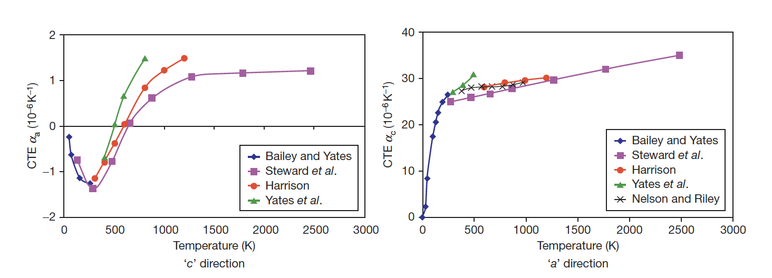
Fundamental Properties
The CTE for graphite displays anisotropic behavior, and strongly varies as a function of temperature
Due to the structure the strength along the basal planes is higher than the strength perpendicular to the planes, and the shear strength between the basal panes is relatively weak
The thermal conductivity along the basal planes is much greater than perpendicular to the planes

Slide 8
Mrozowski Cracks
During the manufacture of artificial graphite, very high temperatures (2800–3000 C) are required
Upon cooling, the anisotropy in thermal expansion coefficients leads to the formation of long, thin microcracks parallel to the basal planes, often referred to as ‘Mrozowski’ cracks
The presence of these microcracks is very important in understanding the properties of nuclear graphite
These cracks for in both TRISO PyC, sometimes called highly orientated pyrolytic graphite (HOPG), and standard nuclear graphite

Slide 9
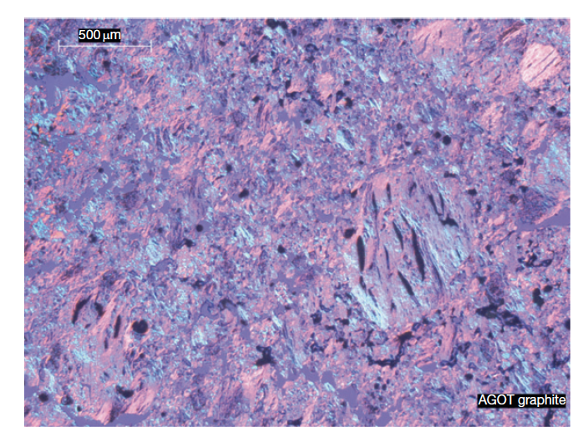
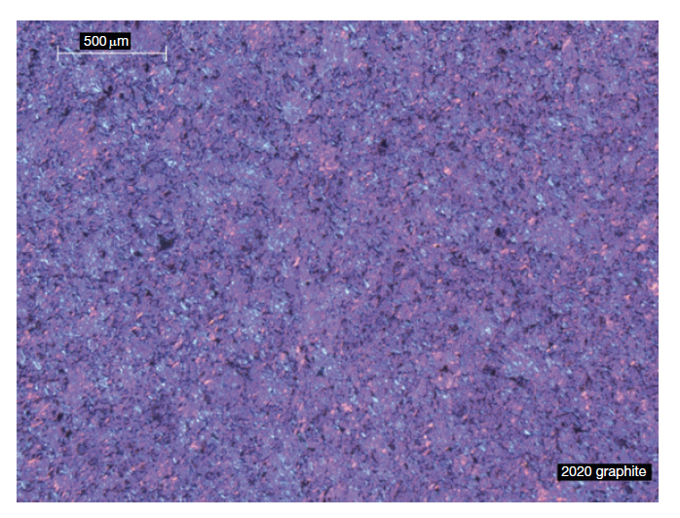
Graphite Texture
Graphite structure is largely dependent upon the manufacturing process
Graphites are classified according to their grain size from coarse-grained (containing grains in the starting mix that are generally >4mm) to microfine-grained (containing grains in the starting mix that are generally <2 mm)
Grade AGOT was used as the moderator in the earliest nuclear reactors in the United States
2020 graphite was a candidate for the core support structure of the modular high temperature gas-cooled reactor in the United States

Slide 10
Initial Porosity
A dominant feature of graphite texture is the amount of porosity
About half the total porosity is open to the surface
The formation of pores and cracks in the graphite during manufacture adds to the texture arising from grain orientation and causes anisotropy in the graphite physical properties
Three origins of porosity:
Those formed by incomplete filling of voids
Gas entrapment during pyrolysis
Thermal cracks

Slide 11
RADIATION EFFECTS IN GRAPHITE

Slide 12
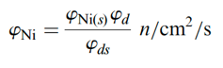
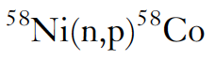
Graphite Shrinkage
When graphite components are irradiated in a reactor, significant changes to their dimensions and properties occur
The unit of irradiation exposure EDND used in the figures is particular to nuclear graphite technology
EDND = Equivalent DIDO Nickel Dose
EDNF = Equivalent DIDO Nickel Flux
They are based upon the equivalent nickel activation in the DIDO reactor

Slide 13
Graphite Shrinkage
Graphite typically shrinks with age until a point is reached where the shrinkage stops, and the graphite starts to swell
This change from shrinkage to swelling is known as "turnaround”
Due to the manufacturing process of nuclear graphite, the graphite component has a much lower density than may be expected (1.7-1.9 g/cm3) compared with 2.2.6 g/cm3 for pure graphite crystals
The original state of the graphite, and the particular radiation defects in graphite, govern this fluence-dependent behavior

Slide 14
Graphite Dimensional Change
Dimensional change data obtained on AGR graphite samples are shown in figure
The higher the temperature the sooner ‘turnaround’ from shrinkage to swelling occurs
This behavior is typical for most semi-isotropic, medium and fine-grained graphite grades, although the magnitude of the changes varies from grade to grade
Nuclear graphite, such as Glisocarbon, is semi-isotropic
Anisotropic graphite can display significantly different irradiation behavior

Slide 15
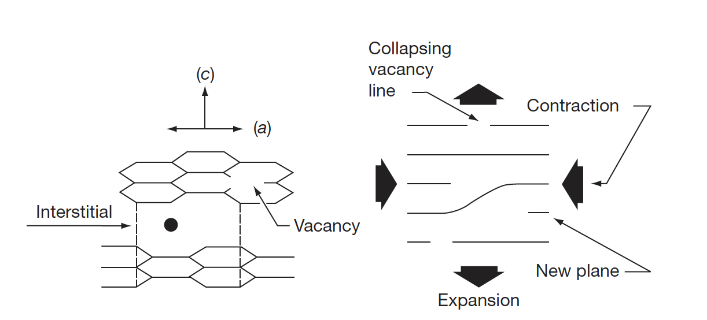
Interstitials in Graphite
The interstitial atom prefers to form a bridge-like structure on the graphene surface
Repelling the two graphene sheets increases c, yielding a corresponding contraction in a
Vacancies shrink the basal plane, further reducing a
Turnaround occurs when the matrix can no longer accommodate the defect-induced dimensional change

Slide 16
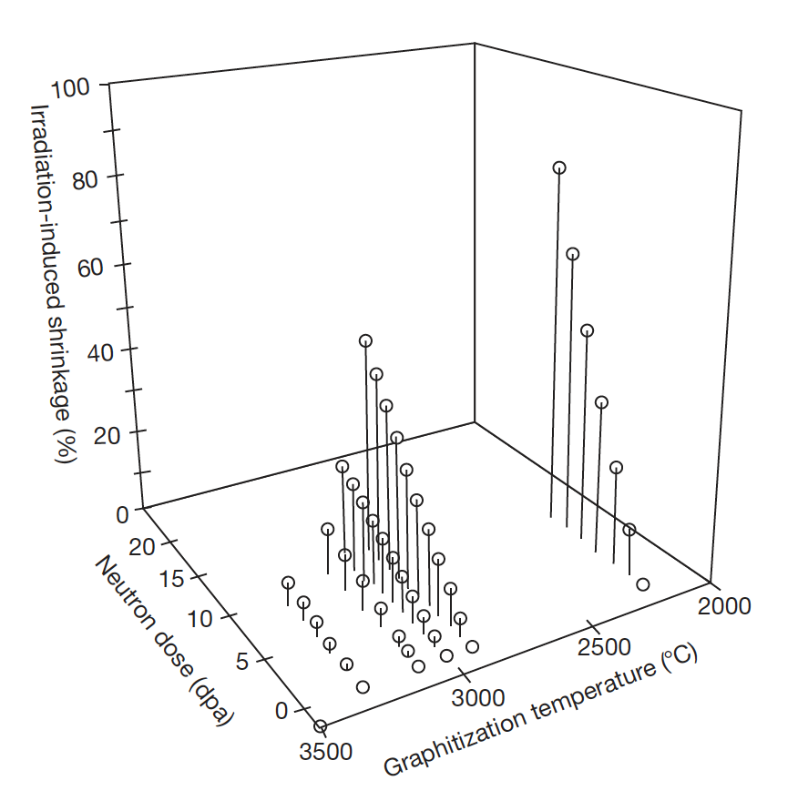
Graphite Shrinkage
Nuclear graphite possess a polycrystalline structure, usually with significant texture resulting from the method of forming during manufacture
Thermal shrinkage cracks that occur during manufacture and that are preferentially aligned in the crystallographic a-direction will initially accommodate the c-direction expansion
So a direction contraction will be observed, and graphite thus undergoes net volume shrinkage
With increasing neutron dose (displacements), the incompatibility of crystallite dimensional changes leads to the generation of new porosity, and the volume shrinkage rate falls, eventually reaching zero
The graphite now begins to swell at an increasing rate with increasing neutron dose

Slide 17
Graphite Irradiation Under Loading
If graphite is irradiated under load the dimensional change data are modified
The difference between loaded and unloaded dimensional change is referred to as creep
The shrinkage is increased under compression and reduced under tension
With increasing fluence the creep strain increases fairly linearly at first, and then the rate reduces before finally increasing

Slide 18
CTE and Young’s Modulus
The behavior of the CTE and E is complex and differs between anisotropic and semi-isotropic grades
The CTE of Gilsocarbon first increases then reduces
For E there an increase with increasing fluence for Glisocarbon
If irradiated past turnaround, significant degradation occurs and the modulus starts to reduce
PGA = Pile Grade A, course, anisotropic graphite
PGA
Glisocarbon

Slide 19
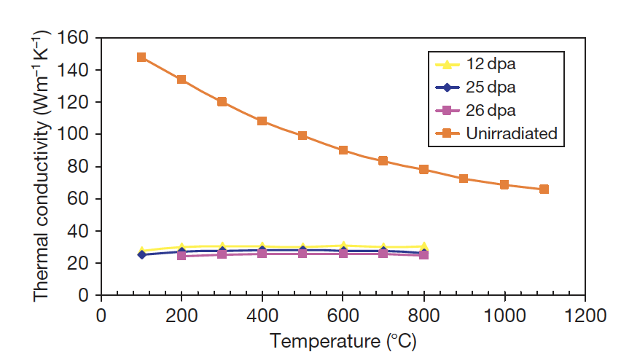
Thermal Conductivity
Graphite is a phonon conductor of heat
Similar to SiC, larger grain size, theoretical densities, low defect content, improve k
The increase of thermal resistance due to irradiation damage has been ascribed to the formation of (1) small interstitial clusters, (2) vacancies, (3) vacancy loops
At any irradiation temperature, the decreasing thermal conductivity will reach a ‘saturation limit’

Slide 20
Impacts of Changes Under Irradiation
In graphite moderated reactors, the graphite structure provides channels for fuel, fuel-cooling and control rod entry, the structural integrity of the graphite components is important from safety and lifetime considerations
Components develop stresses which need to be accounted for
Temperature distribution across a graphite channel is shown at the right
Fluence also changes radially
Fuel is in the center (bore)

Slide 21
Impacts of Changes Under Irradiation
Properties and dimensions change as a function of both temperature and fluence
First, the graphite brick will shrink faster at the bore than at the outside, and properties will vary radially
Graphite brick internal shrinkage and thermal stresses are generated; first tensile at the bore and compressive at the outside, and then reversing in sign towards the end of reactor life
Fortunately much of this stress is reduced by irradiation creep

Slide 22
Impacts of Changes Under Irradiation
Discontinuities in the figure are due to shutdowns every 2 years
The difference in CTE between the inside and the outside of the brick, along with irradiation creep, causes the stresses to significantly change when the reactor is shutdown and the graphite cools
The change in stress at shutdown is mainly due to the temperature difference across the brick, which creep out during reactor operation
Towards the EOL, this leads to significantly different stress states for the inside/outside of the graphite brick

Slide 23
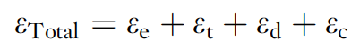
Irradiation Creep
Graphite will undergo creep (inelastic strain) during neutron irradiation and under stress at temperatures where thermal creep is generally negligible
Creep is so fundamentally important to graphite that if irradiation-induced stresses in graphite moderators could not relax via radiation creep, rapid core disintegration would result
One study showed that a 50% decrease in the assumed creep strain resulted in a 50% increase in the predicted hoop stress in a hollow cylindrical core brick
The total strain, in a graphite component under irradiation in a reactor core is given by:
where ε_{e} is the elastic strain; ε_{t}, the thermal strain; ε_{d}, the dimensional change strain; and ε_{c} is the creep strain

Slide 24
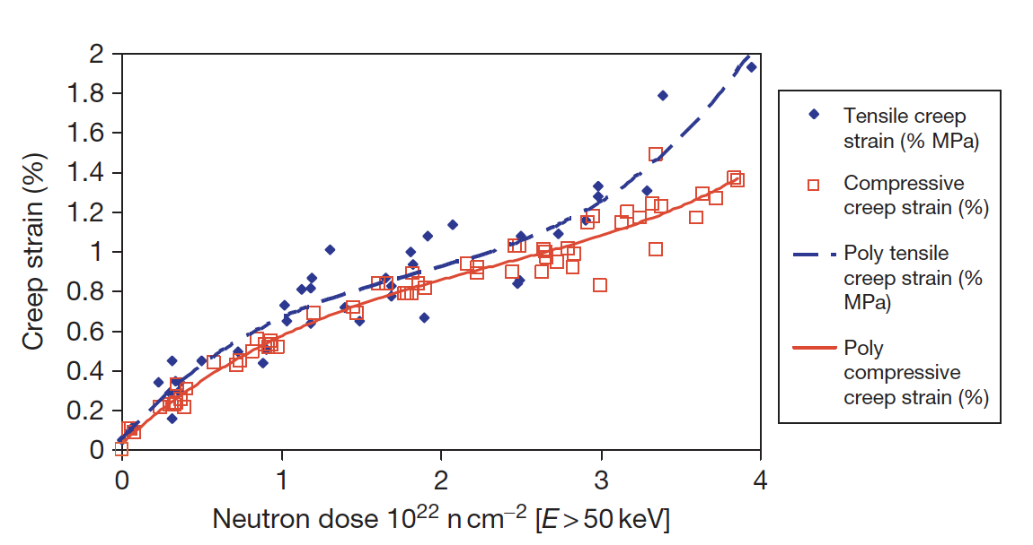
Irradiation Creep
Because of the significance of irradiation-induced creep to the stress levels in graphite core components, accurate models of creep have long been sought, but current models tend to break down at high temperature and fluence
Stress state (compressive/tensile) has an impact on the creep rate
The creep rate increases more rapidly in the tensile loading case compared to the compressive case at high dose

Slide 25
Irradiation Creep
Irradiation-induced basal plane dislocation pinning/unpinning in the graphite crystal is the expected mechanism for the irradiation-induced creep
The pinning points are speculated to be interstitial atom clusters
The interstitial clusters are temporary barriers as they are destroyed by further irradiation
The concentration of pinning sites increases under irradiation from the initial value to a steady-state concentration
The initial creep rate is high and decreases to a near steady-state value as the pinning concentration saturates at a level controlled by the neutron flux and temperature
At high dose, the creep rate can again increase because of (1) high internal stress enhancing the creep rate, and (2) the destruction of interstitial pins by thermal diffusion of vacancies

Slide 26
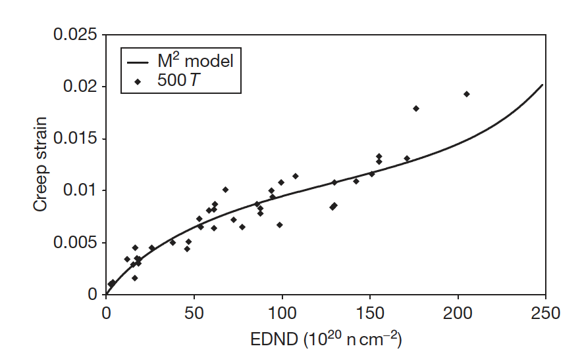
Irradiation Creep Models
Since creep is so important to graphite, a number of creep prediction models have been developed:
Linear viscoelastic creep, UK creep, Kennedy, Kelly and Burchell, etc.
These models can take into account evolving pore structure, thermal expansion, recoverable strain, etc.
The M² model potentially performs the most accurately as a function of dose at relatively low temperatures
However, no model is sufficiently accurate at both high dose and high temperature

Slide 27
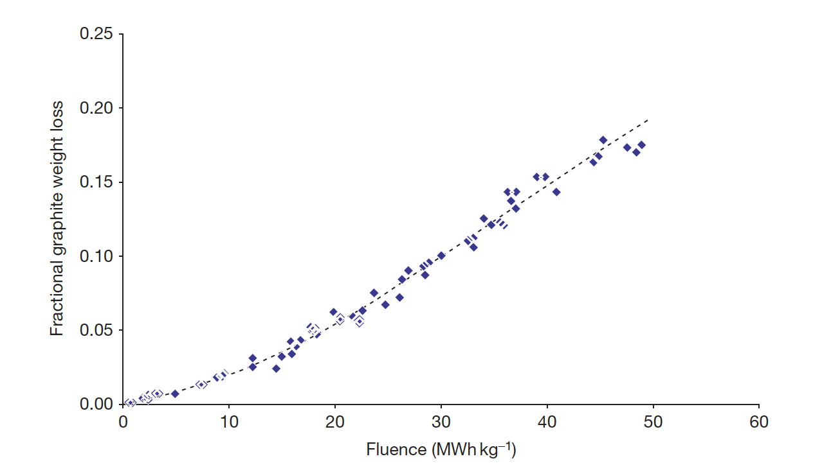
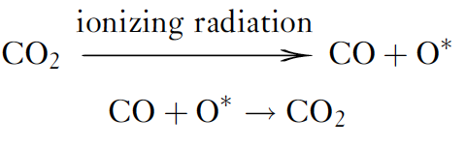
Radiolytic Oxidation
In carbon dioxide (CO2)-cooled reactors, two types of oxidation can occur: thermal and radiolytic
Radiolytic oxidation occurs when CO2 is decomposed by ionizing radiation (radiolysis) to form CO and an active oxidizing species (something like CO3), which attacks the graphite
Radiolytic oxidation occurs predominantly within the graphite open porosity
Can result in weight loss and wastage from graphite

Slide 28
Fabrication

Slide 29
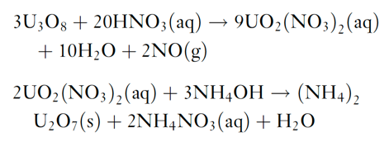
Fuel Kernel Fabrication
The sol–gel technique for kernel microsphere preparation is based on the following two chemical reactions starting from U3O8 powder
The (NH4)2U2O7 (ammonium di-uranate – ADU) is converted to UO2 by sintering in hydrogen gas
For the production of UCO kernels, carbon black is added to the broth and the sintering is performed in CO gas to ensure adequate C/O stoichiometry

Slide 30
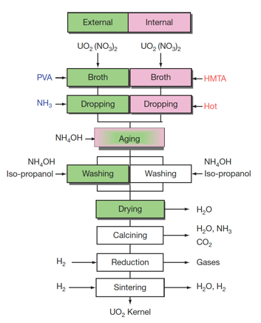
Fuel Kernel Fabrication
The mechanical strength of the coated layers depends on their thickness and sphericity, and thus strongly depend on the diameter and sphericity of the kernels
Vibrating nozzles from which droplets are emitted with high speed were developed for uniform and spherical kernel fabrication
A process is applied to prevent the deformation of droplets while they are landing on the ammonia water, where droplets are solidified while falling in ammonia gas blown against them

Slide 31
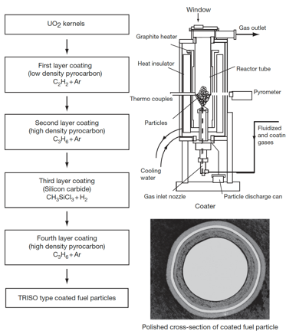
SiC (and PyC) Fabrication
The coating technology of both the SiC and PyC layers involves a fluidization of the kernel microsphere bed and chemical vapor deposition (CVD) coating
TRISO coating process is divided into four coating processes for the porous PyC, IPyC, SiC, and final OPyC layers
A specific mixture of gases is used for the deposition of each layer
buffer: C2H2+Ar; IPyC/OPyC: C3H6+Ar; SiC: CH3SiCl3+H2

Slide 32
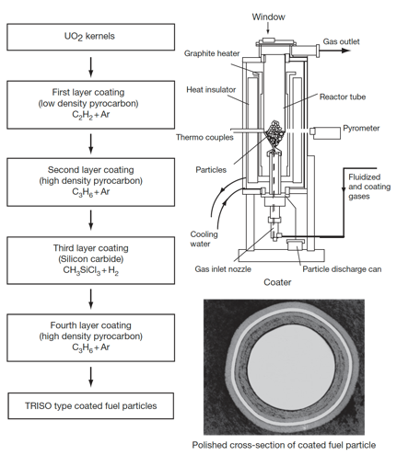
TRISO Fabrication
Rigorous control is applied at every step of the fabrication process to produce high-quality, very low-defect fuel
Defect levels are typically on the order of one defect per 100,000 particles
Specifications are placed on the diameters, thicknesses, and densities of the kernel and layers; the sphericity of the particle; the stoichiometry of the kernel; the isotropy of the carbon; and the acceptable defect levels for each layer

Slide 33
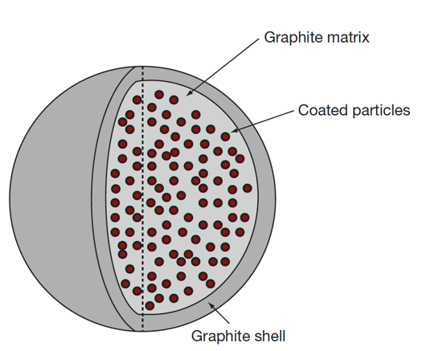
Pebble and Compact Fabrication
The fuel element of the pebble bed type HTGR is a spherical fuel element
The coated particles are overcoated with a layer of matrix graphite powder (MGP) and pressed to the core of a fuel sphere
Then, an additional 5-mm layer of matrix graphite material is added to form a ‘nonfuel’ zone
The resulting fuel sphere gets its final diameter by a machining process and is then carbonized and annealed at 2000C

Slide 34
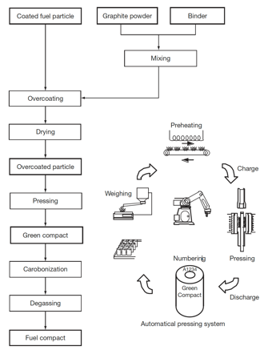
Pebble and Compact Fabrication
HTGR fuel elements are graphite compacts stacked into a graphite core
To form compacts, coated fuel particles are overcoated with the MGP and warm-pressed to make the annular cylinder of green compacts
Green compacts are heat treated for carbonization at 800C and then sintered at 1800C to make fuel compacts
In order to decrease the failure fraction of coating layers, it is necessary to disperse coated fuel particles in a green compact as uniformly as possible

Slide 35
Summary
Graphite day
Graphite has a lot of texture and porosity, dependent upon fabrication
Graphite shrinks, then undergoes turnaround
This behavior is governed by point defects and Mrozowski cracks
Turnaround happens quicker at higher temperatures, and it dependent upon applied stress
Irradiation creep is critically important in graphite
Fabrication of pebbles/compacts

